Slide 1
Clustering

Slide 2
Clustering
Clustering is an unsupervised machine learning task that automatically divides the data into clusters, or groups of similar items.
unsupervised classification because, in a sense, it classifies unlabeled examples.
clustering is used for knowledge discovery rather than prediction.
It provides an insight into the natural groupings found within data.
Clustering is guided by the principle that items inside a cluster should be very similar to each other, but very different from those outside.

Slide 3
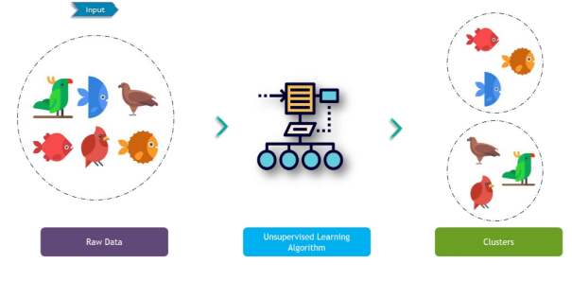

Slide 4
Applications
Segmenting customers into groups with similar demographics or buying patterns for targeted marketing campaigns
Detecting anomalous behavior, such as unauthorized network intrusions, by identifying patterns of use falling outside the known clusters
• Simplifying extremely large datasets by grouping features with similar values into a smaller number of homogeneous categories

Slide 5
K-Means Algorithm
The working of the K-Means algorithm is explained in the below steps:
Step-1: Select the number K to decide the number of clusters.
Step-2: Select random K points or centroids.
Step-3: Assign each data point to their closest centroid, which will form the predefined K clusters.
Step-4: Calculate the variance and place a new centroid of each cluster.
Step-5: Repeat the third steps, which means reassign each datapoint to the new closest centroid of each cluster.
Step-6: If any reassignment occurs, then go to step-4 else go to FINISH.
Step-7: The model is ready.

Slide 6
The k-means algorithm assigns each of the n examples to one of the k clusters, where k is a number that has been determined ahead of time. The goal is to minimize the differences within each cluster and maximize the differences between the clusters.
Unless k and n are extremely small, it is not feasible to compute the optimal clusters across all the possible combinations of examples.
Algorithm uses a heuristic process that finds locally optimal solutions. This means that it starts with an initial guess for the cluster assignments, and then modifies the assignments slightly to see whether the changes improve the homogeneity within the clusters.

Slide 7
The algorithm essentially involves two phases.
First, it assigns examples to an initial set of k clusters. Then, it updates the assignments by adjusting the cluster boundaries according to the examples that currently fall into the cluster.
The process of updating and assigning occurs several times until changes no longer improve the cluster fit. At this point, the process stops and the clusters are finalized.

Slide 8
Using distance to assign and update clusters
The k-means algorithm begins by choosing k points in the feature space to serve as the cluster centers.
The points are chosen by selecting k random examples from the training dataset.
In an example k = 3 points will be selected at random. These points are indicated by the star, triangle, and diamond in the following diagram

Slide 9
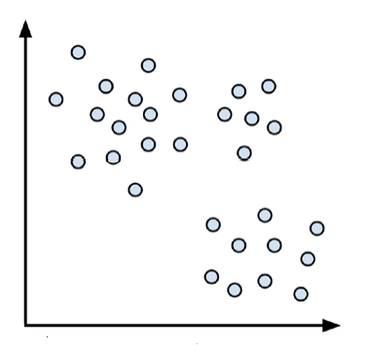
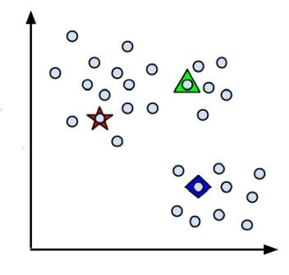

Slide 10
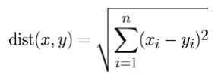
After choosing the initial cluster centers, the other data points are assigned to the cluster center that is nearest according to the distance function. Traditionally, k-means uses Euclidean distance, but Manhattan distance or Minkowski distance are also sometimes used.
If n indicates the number of features, the formula for Euclidean distance between example x and example y is:

Slide 11
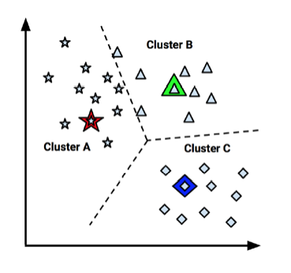
The three cluster centers partition the examples into three segments labeled Cluster A, Cluster B, and Cluster C. The dashed lines indicate the boundaries for the Voronoi diagram created by the cluster centers. The Voronoi diagram indicates the areas that are closer to one cluster center than any other.

Slide 12
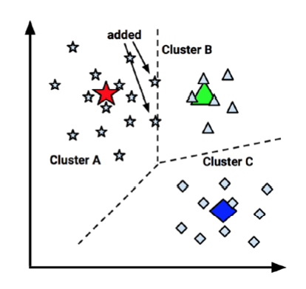
Now that the initial assignment phase has been completed, the k-means algorithm proceeds to the update phase. The first step of updating the clusters involves shifting the initial centers to a new location, known as the centroid, which is calculated as the average position of the points currently assigned to that cluster. The following diagram illustrates how as the cluster centers shift to the new centroids, the boundaries in the Voronoi diagram also shift and a point that was once in Cluster B (indicated by an arrow) is added to Cluster A

Slide 13
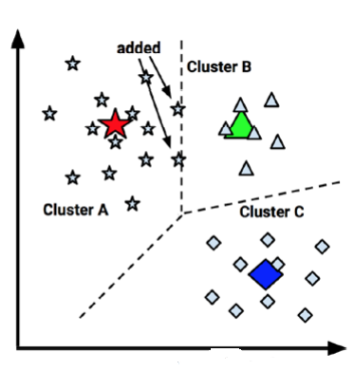
As a result of this reassignment, the k-means algorithm will continue through another update phase. After shifting the cluster centroids, updating the cluster boundaries, and reassigning points into new clusters (as indicated by arrows), the figure looks like this:

Slide 14
Because two more points were reassigned, another update must occur, which moves the centroids and updates the cluster boundaries. However, because these changes result in no reassignments, the k-means algorithm stops. The cluster assignments are now final:

Slide 15
Without any prior knowledge, one rule of thumb suggests setting k equal to the square root of (n / 2), where n is the number of examples in the dataset. However, this rule of thumb is likely to result in an unwieldy number of clusters for large datasets.
A technique known as the elbow method attempts to gauge how the homogeneity or heterogeneity within the clusters changes for various values of k.
The homogeneity within clusters is expected to increase as additional clusters are added; similarly, heterogeneity will also continue to decrease with more clusters.
The value of k , that look like elbow is known as elbow point. This value of k can be selected.

Slide 16
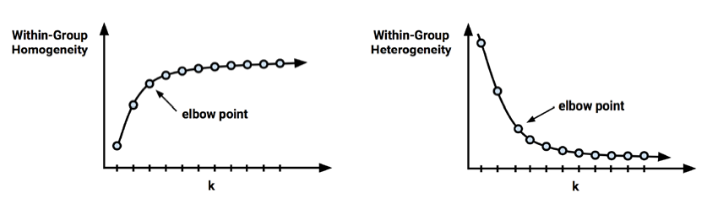

Slide 17
EVALUATING PERFORMANCE OF THE MODEL

Slide 18
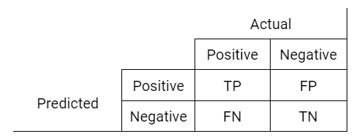
confusion matrix
It is an N x N matrix that gives a summary of the correct and incorrect predicted classification results for the Ntarget classes.
The values in the diagonal of the matrix represent the number of correctly predicted classes while every other cell in the matrix indicates the misclassified classes.
This means that the more predicted values that fall in the diagonal, the better the model. True positive, false positive, true negative and false negative are terms used when interpreting a confusion matrix.

Slide 19
True Positive (TP): This is a correct classification where the predicted value is the same as the actual value. Using the table above, this means that actual value was positive and the predicted value was also positive.
True Negative (TN): The predicted value also matches the actual value. In this case, it is for the negative class. The actual value is negative and the predicted value is negative.
False Positive (FP): Also called a Type I error, this is a misclassification such that the model predicted a positive class while the actual class is negative. Telling a man that he is pregnant is definitely a false positive.
False Negative (FN): Also another misclassification where the predicted value is negative and the actual value is positive. Another example will be telling a pregnant woman that she is not pregnant. FN is known as a Type II error.

Slide 20
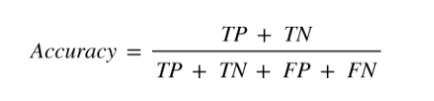
Accuracy
This is the ratio of the number of correctly predicted instances to the total number of instances. It is a commonly used metric suitable when the target classes are not imbalanced. A high accuracy does not necessarily mean that the model has high predicting power. Hence, depending on the task, it is important to not use only the accuracy metric because it does not provide enough information about the model.

Slide 21

The error rate or the proportion of the incorrectly classified examples is specified as:

Slide 22

Precision
The ratio of correctly predicted instances of a class to the total number of items predicted by the model to be in that class is referred to as precision (known as Positive Predicted Value - PPV). This translates to the total percentage of the results obtained that are relevant. For the positive class, it is the ratio of true positives to the sum of true positives and false positives

Slide 23

Recall (sensitivity)
Recall gives a percentage of total relevant results correctly predicted by the model. It is the ratio of the true positives to the actual number of positives (true positives and false negatives).

Slide 24

specificity
The specificity of a model (also called the true negative rate) measures the proportion of negative examples that were correctly classified. As with sensitivity, this is computed as the number of true negatives, divided by the total number of negatives—the true negatives plus the false positives.

Slide 25

F1-Score
This metric is the harmonic mean of precision and recall that aims to have an optimal balance of both. The F1-Score is quite easy to use and can be focused on to maximize as opposed to maximizing precision and recall.

Slide 26
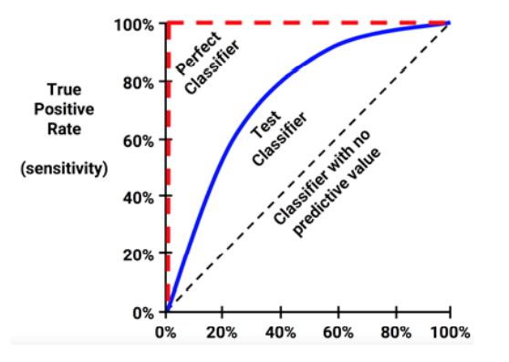
ROC Curve
The Receiver Operating Characteristics (ROC) curve is a probability curve that measures the performance of a classification model at different set thresholds. True Positive Rate (TPR) is plotted on the y-axis against the False Positive Rate (FPR) on the x-axis.

Slide 27
Curves are defined on a plot with the proportion of true positives on the vertical axis and the proportion of false positives on the horizontal axis. Because these values are equivalent to sensitivity and (1 – specificity), respectively, the diagram is also known as a sensitivity/specificity plot.
Diagonal line from the bottom-left to the top-right corner of the diagram represents a classifier with no predictive value. This type of classifier detects true positives and false positives at exactly the same rate, implying that the classifier cannot discriminate between the two.
The perfect classifier has a curve that passes through the point at a 100 percent true positive rate and 0 percent false positive rate.

Slide 28
Area under the ROC curve(AUC)
The closer the curve is to the perfect classifier, the better it is at identifying positive values. This can be measured using a statistic known as the area under the ROC curve (abbreviated AUC). The AUC treats the ROC diagram as a two-dimensional square and measures the total area under the ROC curve. AUC ranges from 0.5 (for a classifier with no predictive value) to 1.0 (for a perfect classifier). A convention to interpret AUC scores uses a system similar to academic letter grades:
• A: Outstanding = 0.9 to 1.0
• B: Excellent/good = 0.8 to 0.9
• C: Acceptable/fair = 0.7 to 0.8
• D: Poor = 0.6 to 0.7
• E: No discrimination = 0.5 to 0.6

Slide 29
Cross Validation (CV)
Cross Validation (CV) is a well known and trusted method applied to avoid overfitting and enable generalization.
Although there are different techniques used in performing cross validation, the fundamental concept involves partitioning the dataset into a number of subsets, holding out a set for evaluation then training the model on the other sets.
This gives a more reliable estimate of how the model performs across different training sets because it provides an average score across different training samples used.
The only drawback with cross validation is that it takes more time and computational resources however, the gain obtained in having a better model is very well worth this cost.

Slide 30
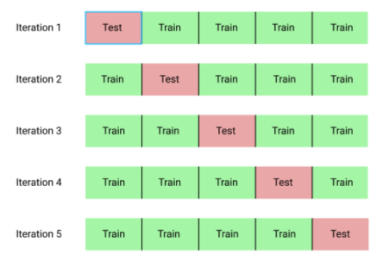
K-Fold Cross Validation
This technique is called K-Fold because the data is split into K equal groups. If k=5,a 5-fold cross validation can be performed such that the data is split into k1, k2, k3, k4 and k5. The model is trained on k2 - k5 and evaluated on k1 then repeated k times until every group is used to train and test the model.

Slide 31
Bootstrap sampling/bootstrap/ bootstrapping
When this principle is applied to machine learning model performance, it implies the creation of several randomly selected training and test datasets, which are then used to estimate performance statistics. The results from the various random datasets are then averaged to obtain a final estimate of future performance.
The bootstrap allows examples to be selected multiple times through a process of sampling with replacement. This means that from the original dataset of n examples, the bootstrap procedure will create one or more new training datasets that will also contain n examples, some of which are repeated. The corresponding test datasets are then constructed from the set of examples that were not selected for the respective training datasets.

Slide 32
Using sampling with replacement as described previously, the probability that any given instance is included in the training dataset is 63.2 percent. Consequently, the probability of any instance being in the test dataset is 36.8 percent.
Because a model trained on only 63.2 percent of the training data is likely to perform worse than a model trained on a larger training set, the bootstrap's performance estimates may be substantially lower than what would be obtained when the model is later trained on the full dataset.
One advantage of bootstrap over cross-validation is that it tends to work better with very small datasets.

Slide 33
Improving Model Performance

Slide 34
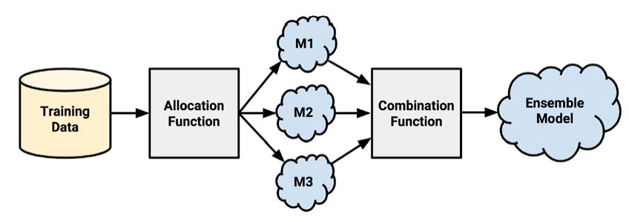
Understanding ensembles
All the ensemble methods are based on the idea that by combining multiple weaker learners, a stronger learner is created.

Slide 35
First, input training data is used to build a number of models. The allocation function dictates how much of the training data each model receives.
After the models are constructed, they can be used to generate a set of predictions, which must be managed in some way. The combination function governs how disagreements among the predictions are reconciled. For example, the ensemble might use a majority vote to determine the final prediction

Slide 36
Bagging
Bagging, also known as bootstrap aggregation, is the ensemble learning method.
Bootstrapping: Bagging leverages a bootstrapping sampling technique to create diverse samples. This resampling method generates different subsets of the training dataset by selecting data points at random and with replacement. This means that each time you select a data point from the training dataset, you are able to select the same instance multiple times. As a result, a value/instance repeated twice (or more) in a sample.
Parallel training: These bootstrap samples are then trained independently and in parallel with each other using weak or base learners.
Aggregation: Finally, depending on the task (i.e. regression or classification), an average or a majority of the predictions are taken to compute a more accurate estimate. In the case of regression, an average is taken of all the outputs predicted by the individual classifiers; this is known as soft voting. For classification problems, the class with the highest majority of votes is accepted; this is known as hard voting or majority voting.

Slide 37
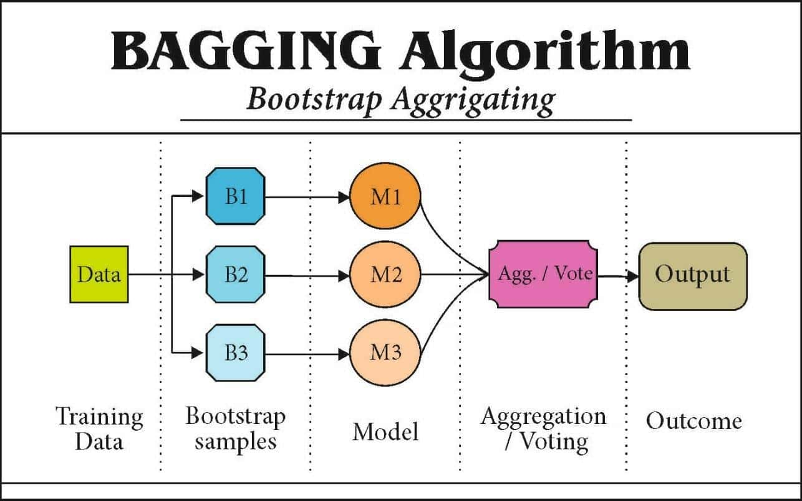

Slide 38
Boosting
Boosting is an ensemble modeling technique that attempts to build a strong classifier from the number of weak classifiers.
It is done by building a model by using weak models in series. Firstly, a model is built from the training data.
Then the second model is built which tries to correct the errors present in the first model.
This procedure is continued and models are added until either the complete training data set is predicted correctly or the maximum number of models are added.

Slide 39
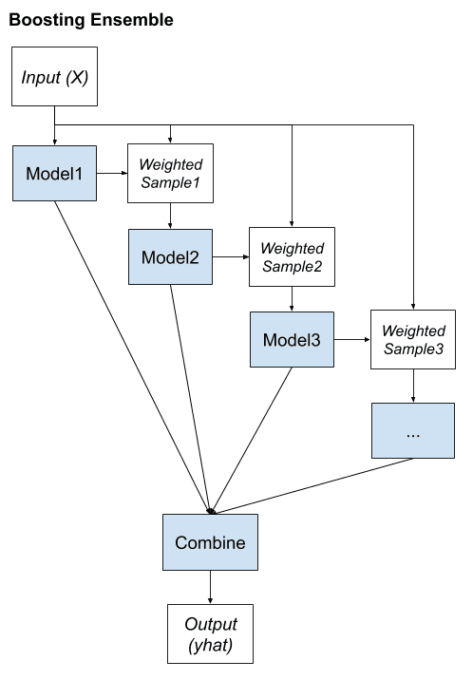

Slide 40
Step 1: The base learner takes all the distributions and assign equal weight or attention to each observation.
Step 2: If there is any prediction error caused by first base learning algorithm, then pay higher attention to observations having prediction error. Then, apply the next base learning algorithm.
Step 3: Iterate Step 2 till the limit of base learning algorithm is reached or higher accuracy is achieved.

Slide 41
AdaBoost was the first really successful boosting algorithm developed for the purpose of binary classification. AdaBoost is short for Adaptive Boosting and is a very popular boosting technique that combines multiple “weak classifiers” into a single “strong classifier”. It was formulated by Yoav Freund and Robert Schapire.
Algorithm:
Initialise the dataset and assign equal weight to each of the data point.
Provide this as input to the model and identify the wrongly classified data points.
Increase the weight of the wrongly classified data points.
if (got required results)
Goto step 5
else
Goto step 2
End

Slide 42
Random forests
Another ensemble-based method called random forests (or decision tree forests) focuses only on ensembles of decision trees.
This method was championed by Leo Breiman and Adele Cutler
Combines the base principles of bagging with random feature selection to add additional diversity to the decision tree models.
After the ensemble of trees (the forest) is generated, the model uses a vote to combine the trees' predictions.

Slide 43
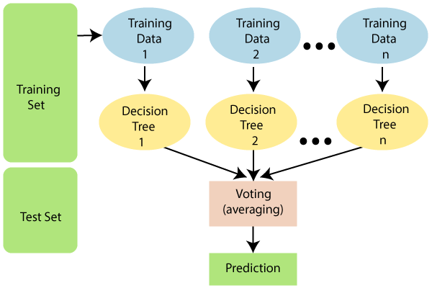

Slide 44
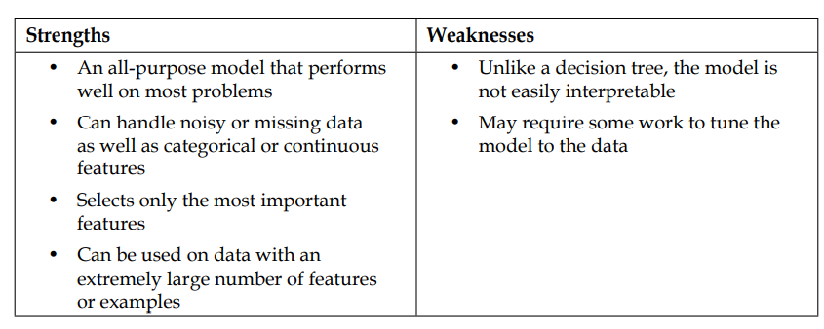
Random forests combine versatility and power into a single machine learning approach. As the ensemble uses only a small, random portion of the full feature set, random forests can handle extremely large datasets.
Random forests tend to be easier to use and less prone to overfitting.

